Slide 1
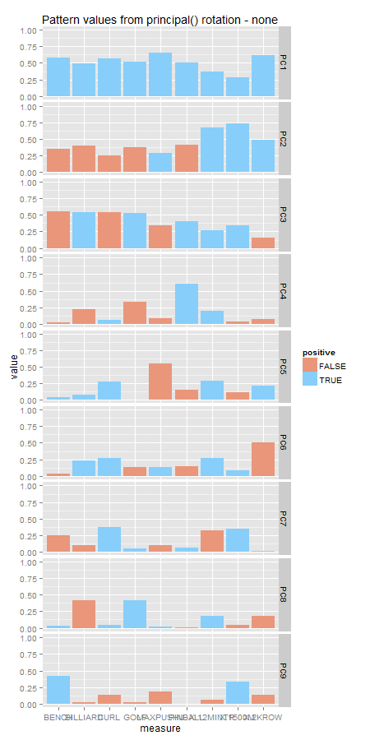
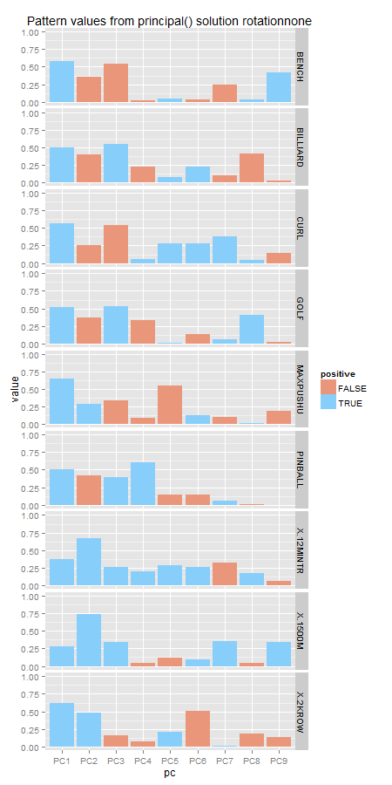
none
varimax
quatimax
promax
oblimin
simplimax
cluster
Notes:
none

Slide 2
Notes:
varimax

Slide 3
Notes:
quatimax

Slide 4
Notes:
promax

Slide 5
Notes:
oblimin

Slide 6
Notes:
simplimax

Slide 7
Notes:
cluster

